Slide 1


NTC Point Loma PHA Process
NMRTU Point Loma
2051 Cushing Road
San Diego, CA
92071
“Anchored in Excellence, Committed to Health!”

Slide 2
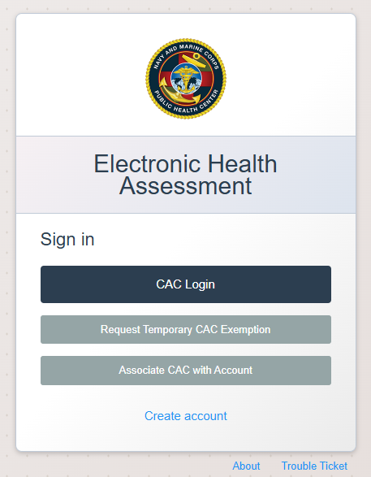
Step 1
Complete Part 1 of the ePHA at the following website:
https://navyeha.health.mil/eha/
This link can also be found via Quick Links on MyNavy Portal.
If you are having trouble logging in, please utilize the “Trouble Ticket” option for assistance on the bottom right of the EHA login.
“Anchored in Excellence, Committed to Health!”

Slide 3
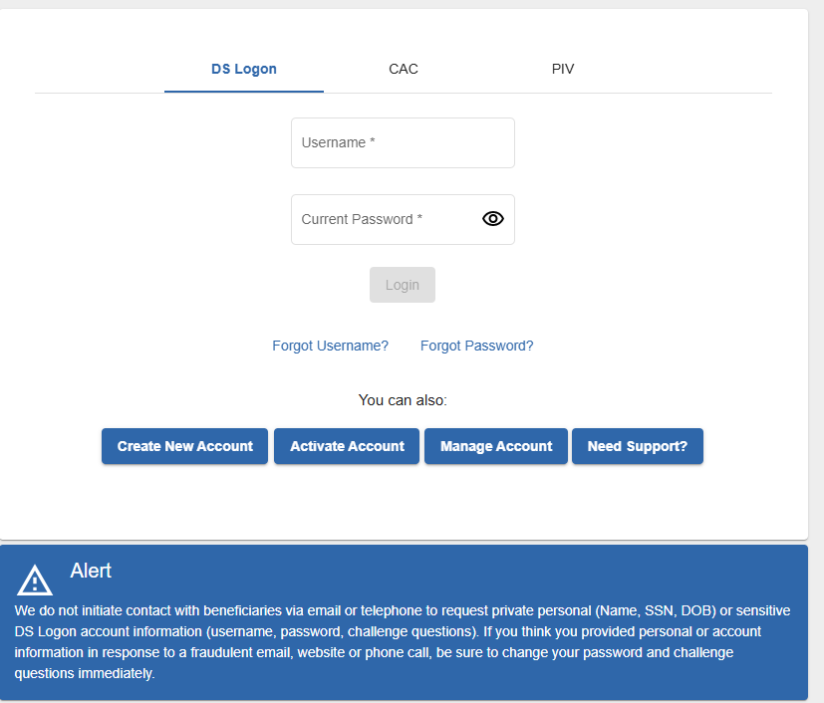
Step 2
Once the EHA is complete, log into MHS Genesis Patient Portal at the following website:
https://myaccess.dmdc.osd.mil/identitymanagement/app/login
If you have previous created a Patient Portal account, this can be accessed without a CAC via username and password.
Reserve obligations
Reserve obligations
Source: Enrollment as of 26AUG24

Slide 4
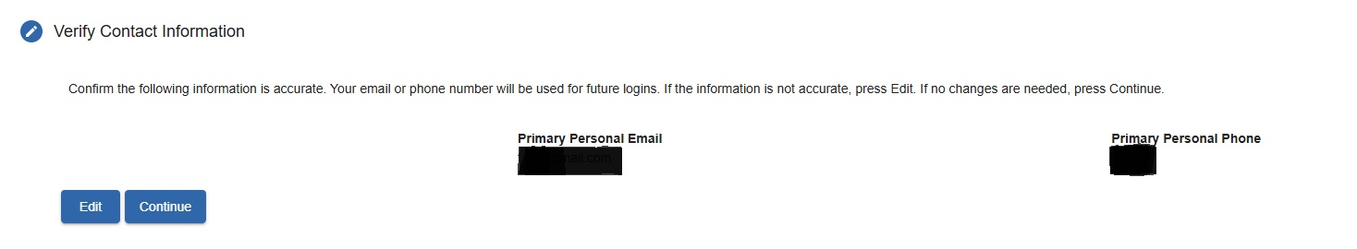
Step 3
Once logged in, verify Contact Information is correct and then press “Continue”.
Source: FMIS as of 26AUG24

Slide 5
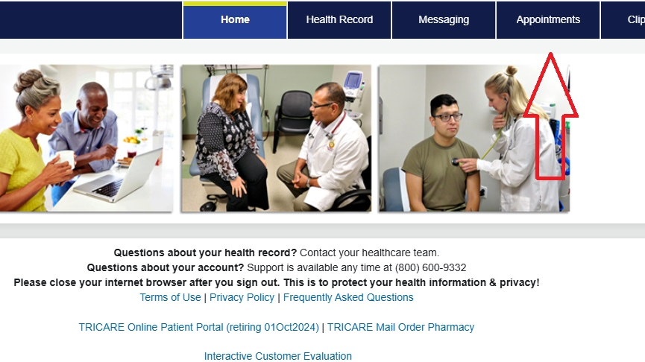
Step 4
Select “Appointment” tab from Patient Portal homepage.
Source: FMIS as of 26AUG24

Slide 6
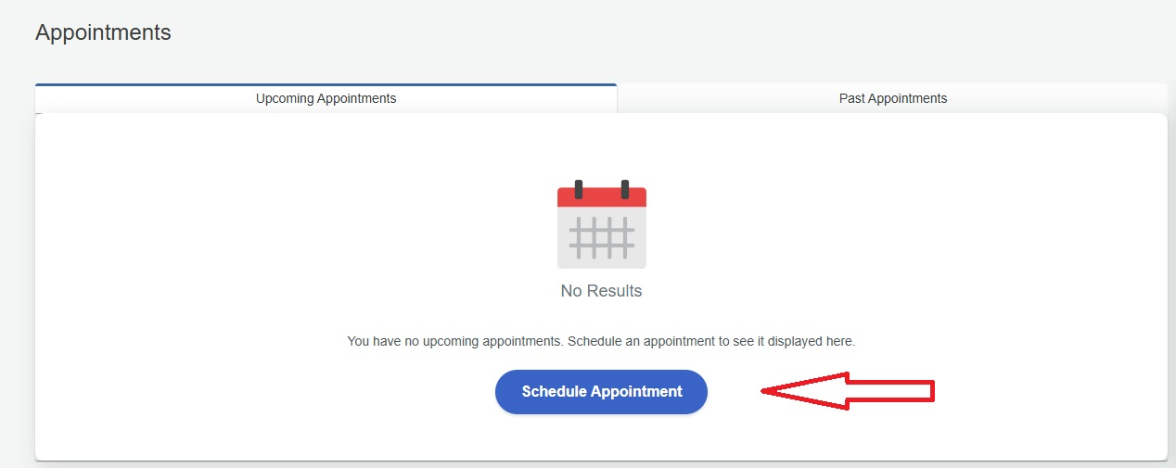
Step 5
Once on the appointment page,
Select “Schedule Appointment”.
Source: FMIS as of 26AUG24

Slide 7
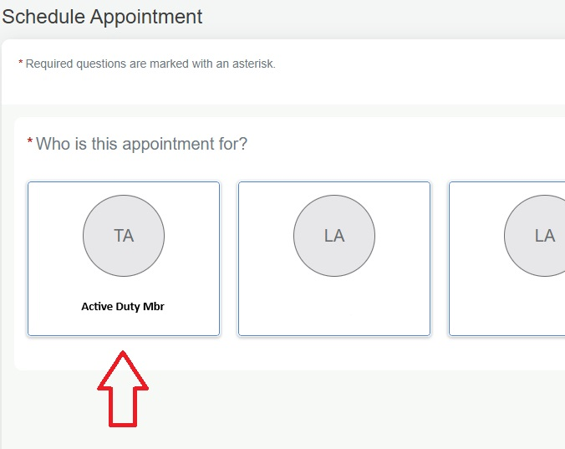
Step 6
If there are multiple accounts/patients under your MHS Genesis, such as dependents, please select the Patient that needs the PHA appointment. If you do not have dependents please skip this step.
(for example, “Active Duty Mbr”)
Source: FMIS as of 26AUG24

Slide 8
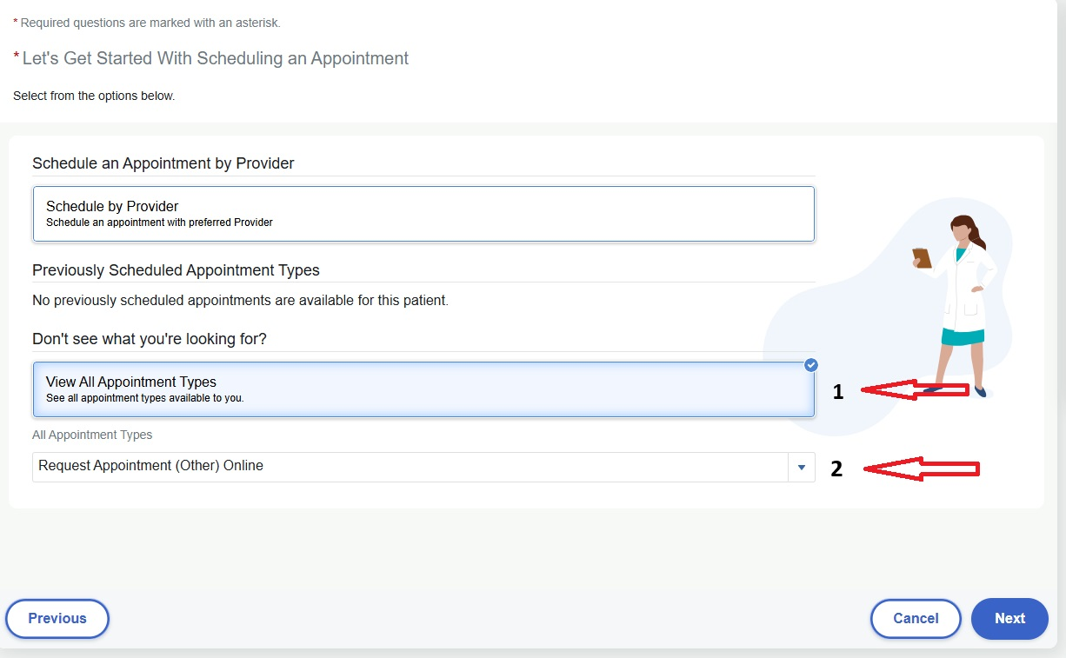
Step 7
Select “View All Appointment Types Tab”
Select “Appointment Type” drop down Tab
Select “Request Appointment (other) Online”
Select “Next”

Slide 9
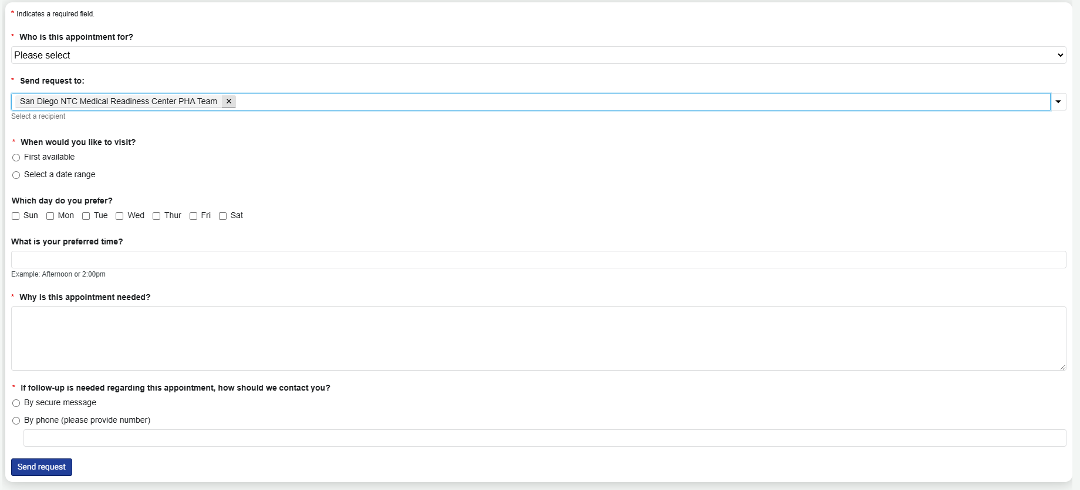
Step 8
Fill out all tabs
In “Send Request to” drop down tab, type in “San Diego NTC Medical Readiness Center PHA Team” Please copy and paste this exactly how it is written to avoid it being sent to an incorrect messaging pool.
In “Why is this appointment needed” tab, type “PHA; PDHA, etc”
Once all tabs completed, select “Send Request”
Source: FMIS as of 26AUG24

Slide 10
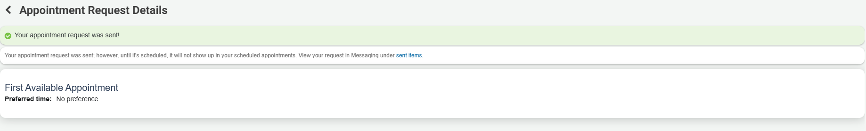
Step 9
Once you have confirmation of your sent request, please allow the PHA team 5-7 business days to respond to the request. Please expect potential delays towards the end of the PRT cycle.
You will be contacted via MHS Genesis Patient Portal message with a virtual, over the phone appointment date and time.
Source: FMIS as of 26AUG24

Slide 11
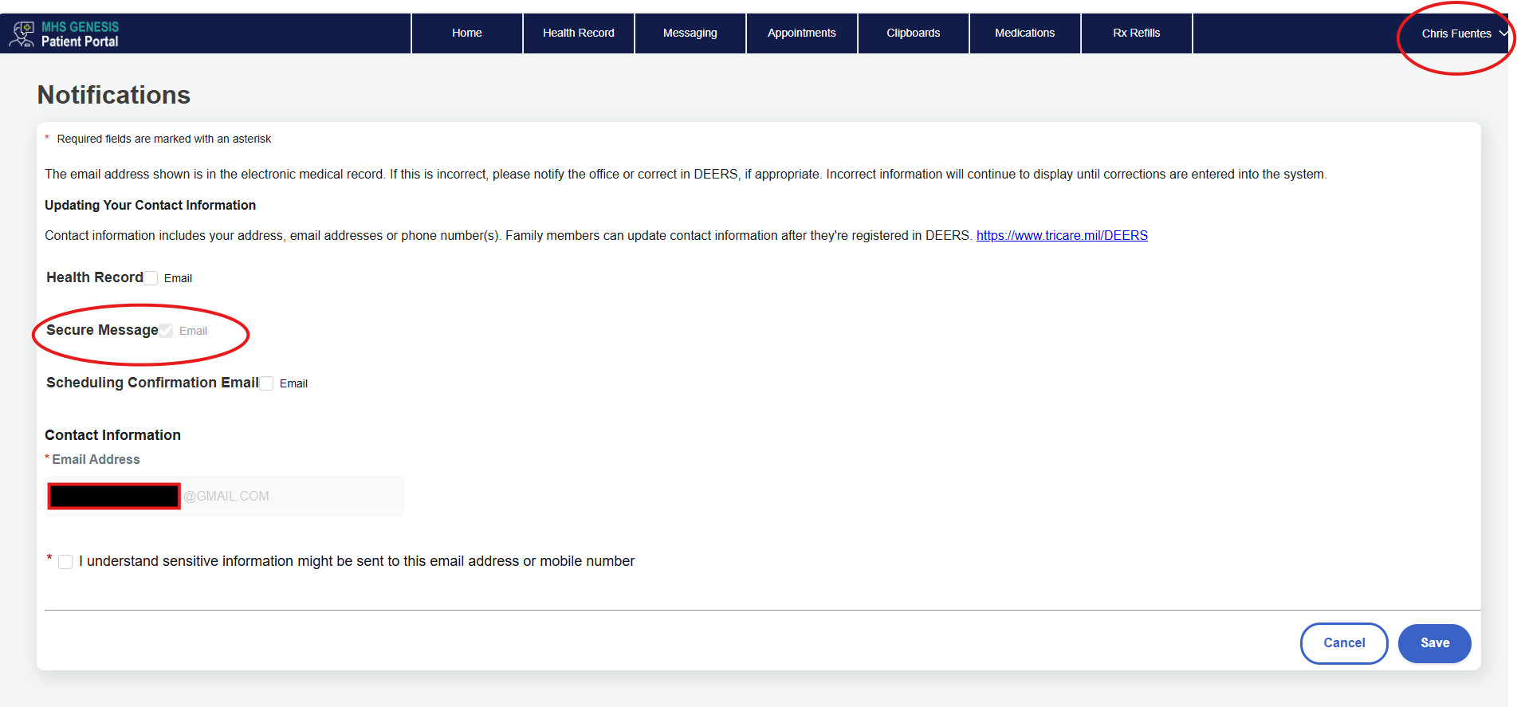
Step 10
To ensure you are notified of your appointment, your notification settings can be modified in the “Notification Preferences” when your name is clicked in the top right corner.
Source: FMIS as of 26AUG24

